Slide 1
The Big Data System
for Used Car Price Evaluation
DSCI-551 Final Project
Tuo Sun, Yidan Wang, Xilai Nian

Slide 2
Content
1
PROJECT TOPIC & SOLUTION SUMMARY
2
SOLUTION PART ONE: API & DATA SET
3
SOLUTION PART TWO: BIG DATA FRAMEWORK
4
SOLUTION PART THREE: DATA PREDICTION MODEL
5
SOLUTION PART FIVE: UI DESIGN & DEMO

Slide 3

1
PROJECT TOPIC & SOLUTION SUMMARY

Slide 4
PROJECT TOPIC
- Accurately and Rapidly Predict the Selling Price of Used Vehicles
- Output the Information of the Nearest Vehicles
Used-Car
Price Prediction

Slide 5
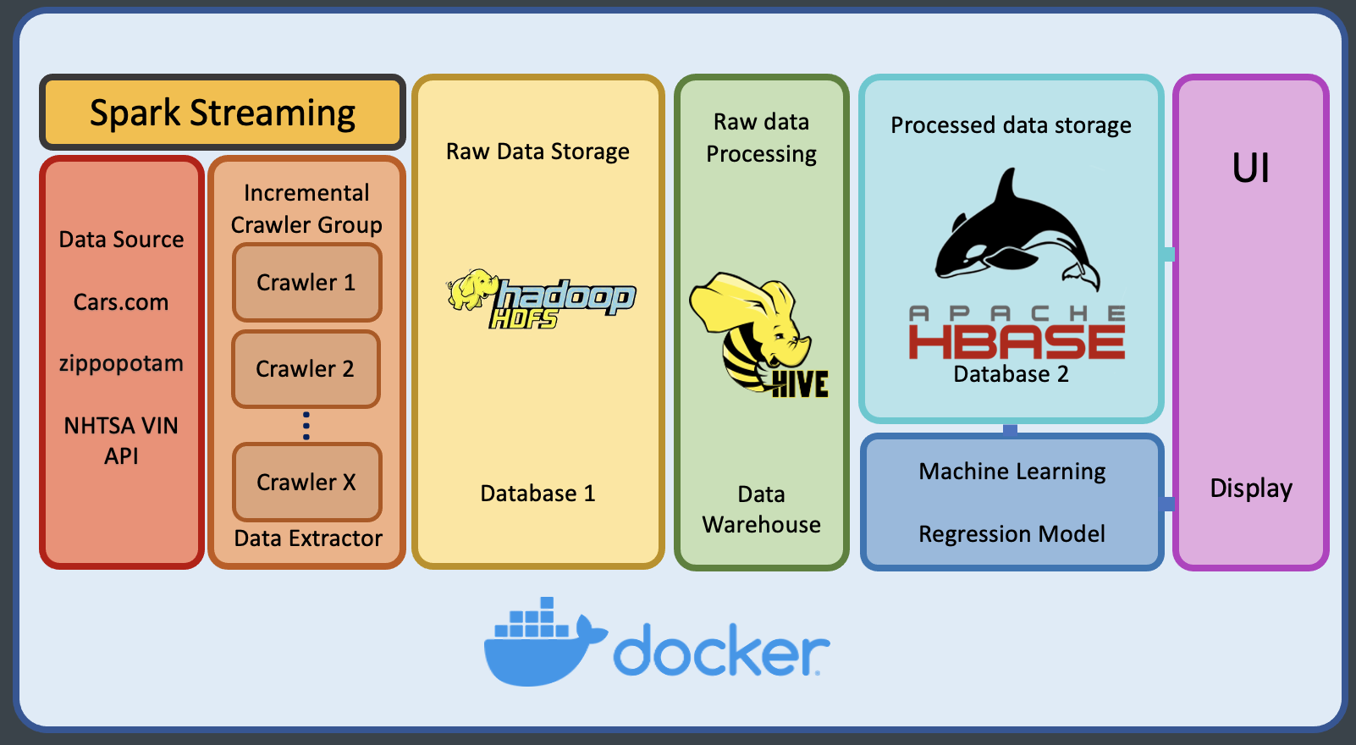
SOLUTION SUMMARY

Slide 6
2
SOLUTION PART ONE: API & DATA SET

Slide 7
API & DATA SET
Data Source
Cars.com
Price
Mileage
Engine
Fuel Type
......
zippopotam.us
State
Longitude
Latitude
......
NHTSA VIN API
Extra Car features

Slide 8
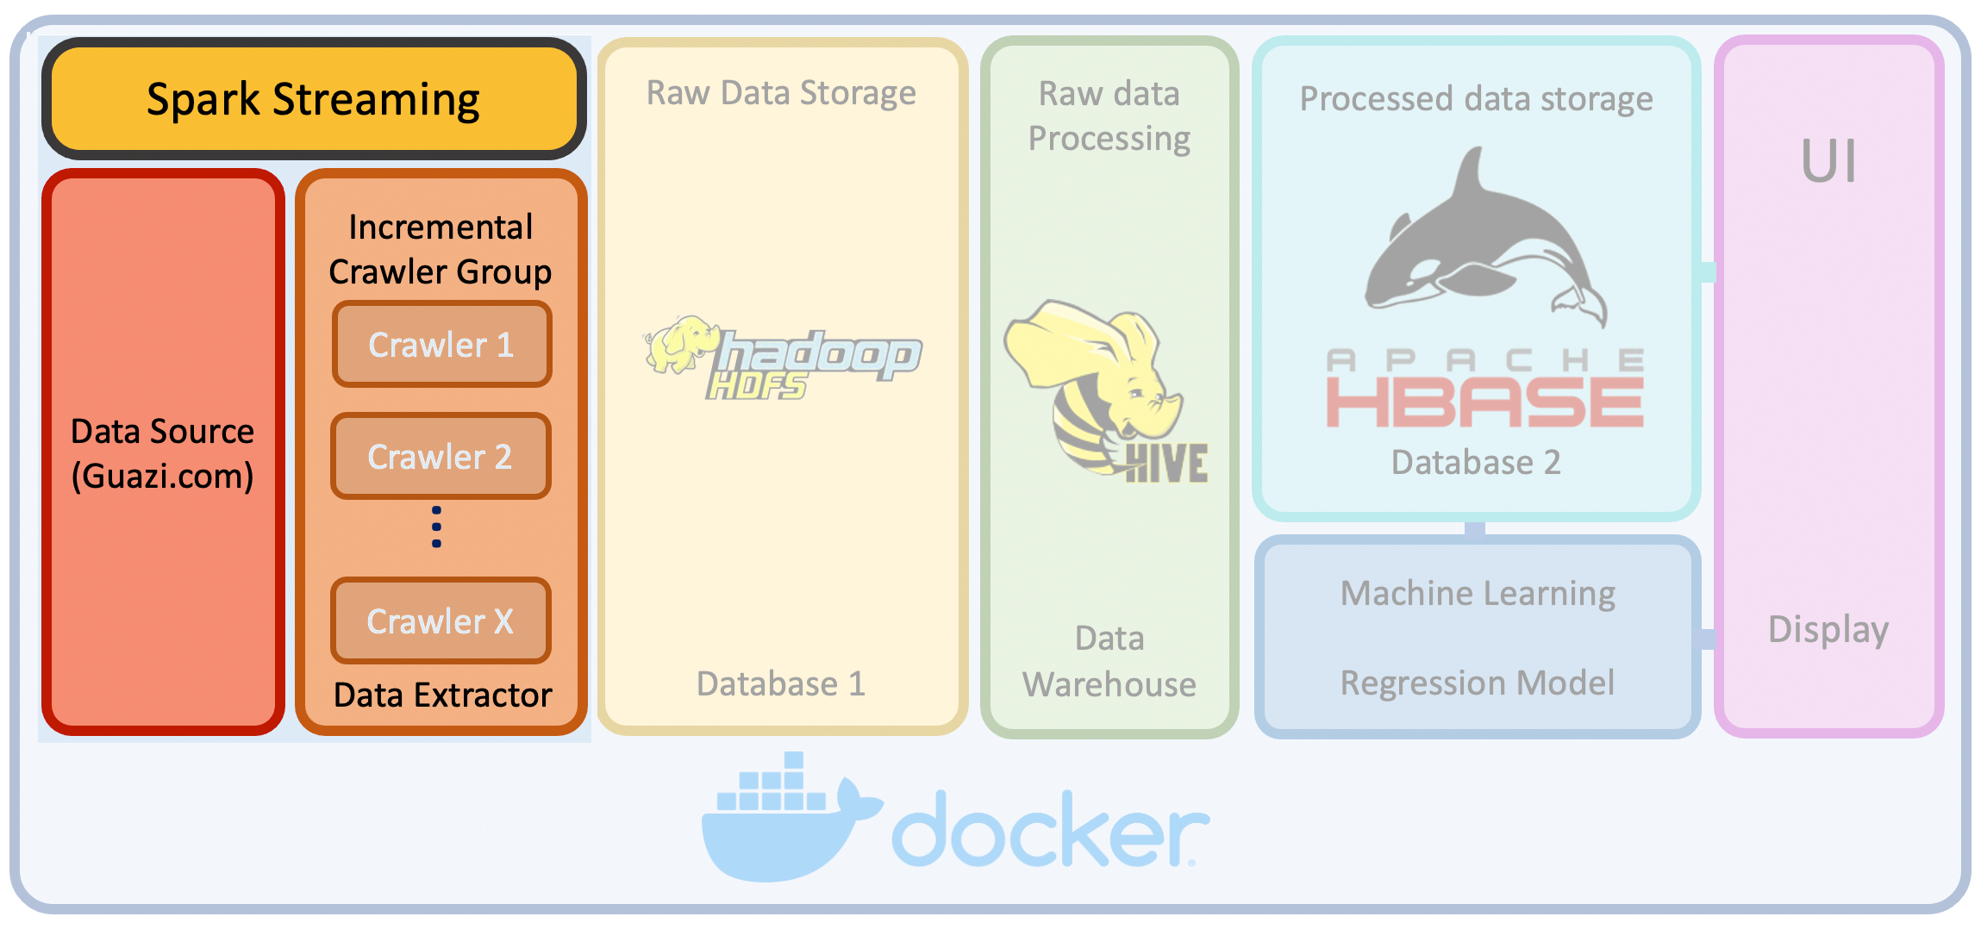
CRAWLERS

Slide 9
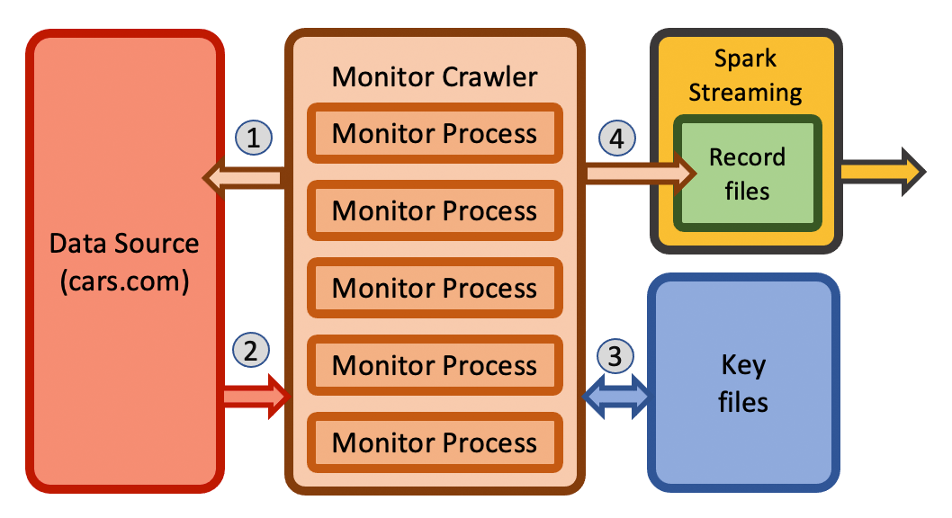
CRAWLERS

Slide 10
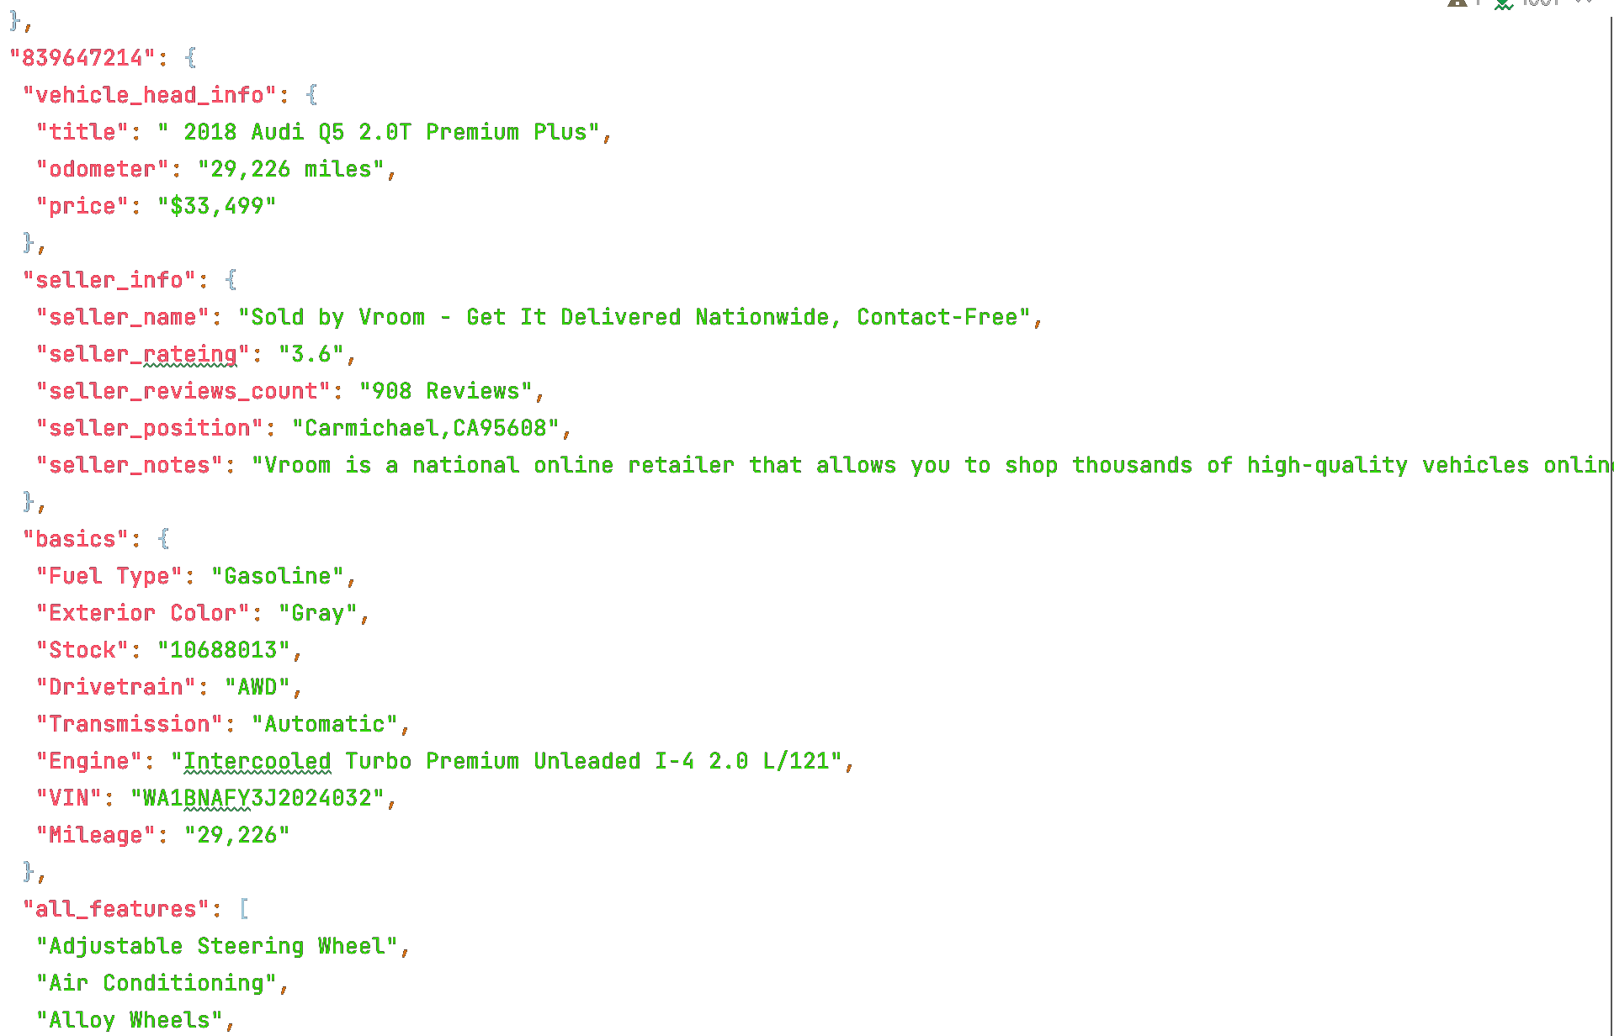
CRAWLERS

Slide 11
3
SOLUTION PART TWO: BIG DATA FRAMEWORK

Slide 12

DOCKER
THE OLD PLAN
Slave 1
Master
Slave 1
Centos + Spark + JDK + Hadoop + Hive
+ HBase + Redis + Zookeeper

Slide 13
DOCKER
HBSE
THE NEW PLAN
Spark V1
Spark V2
Hive V1
Hive V2
Hadoop
Zookeeper
JDK8
Redis
Centos

Slide 14
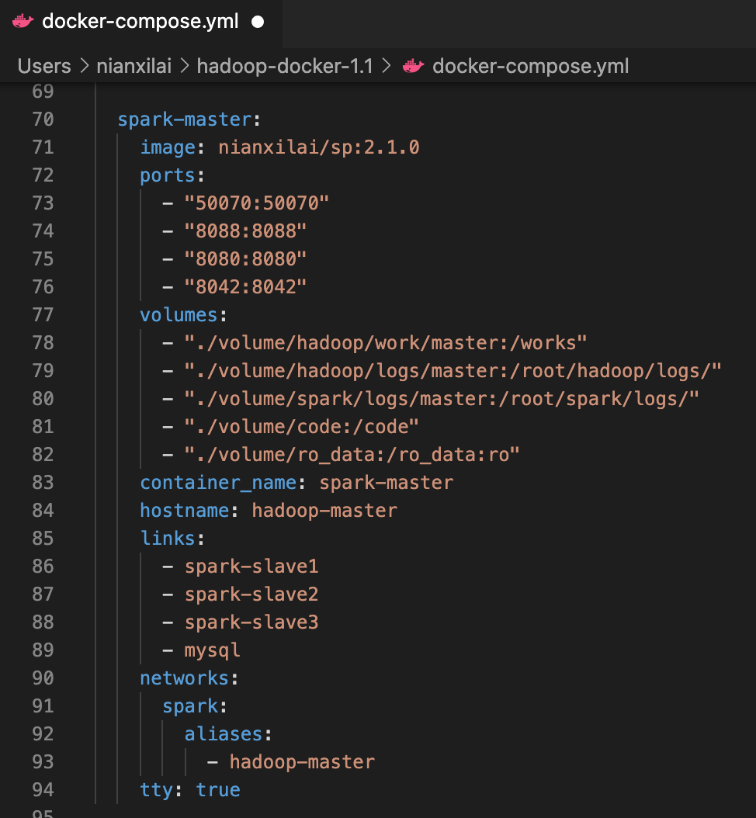
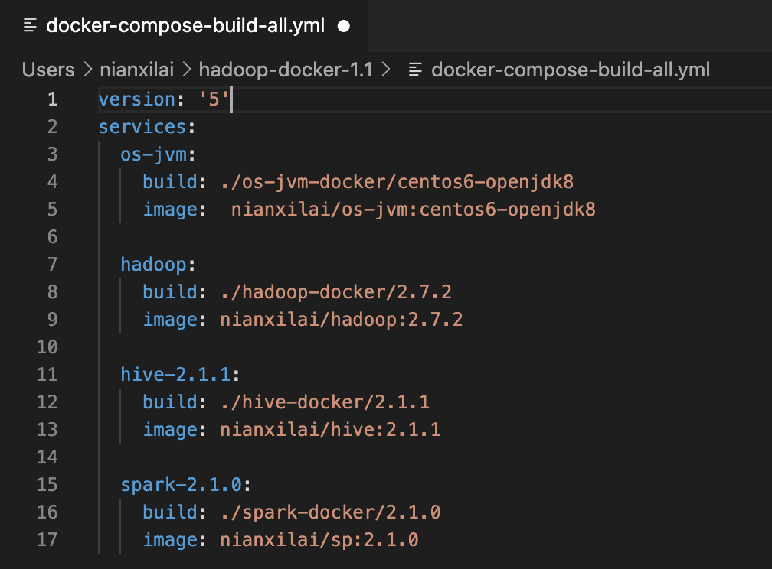
DOCKER

Slide 15
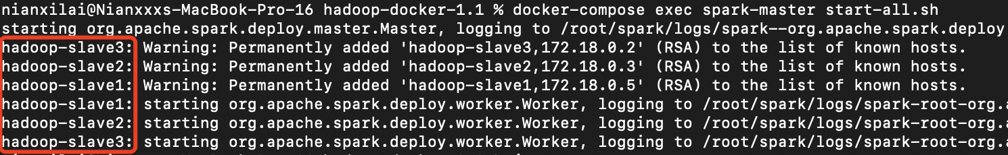
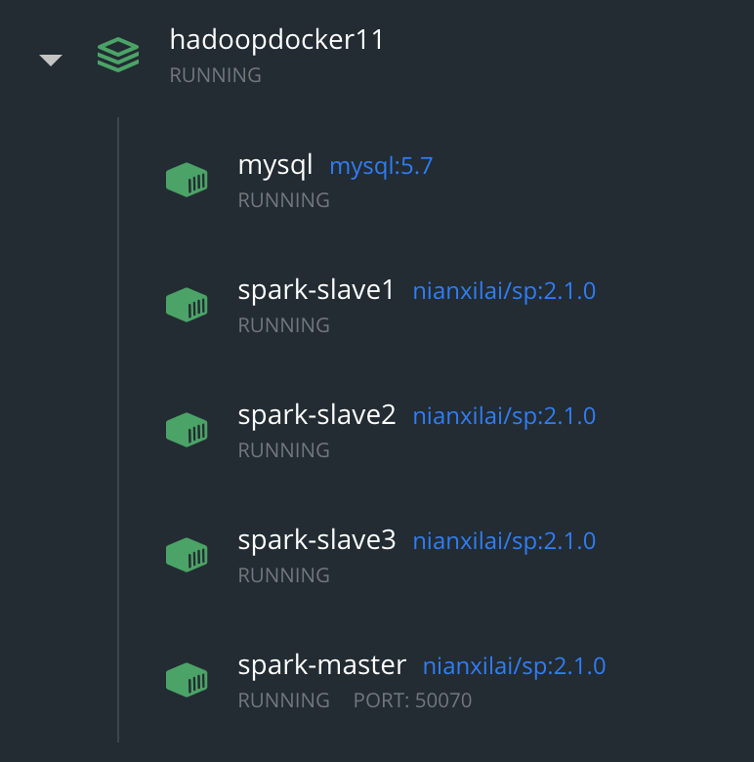

Hadoop
Slave 1
Slave 2
Slave 3
Slave 4
Master

Slide 16
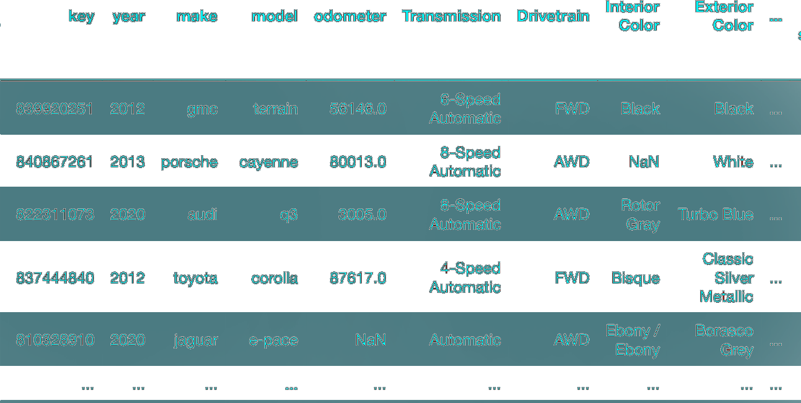
HIVE + HBSE

Slide 17
4
SOLUTION PART THREE: DATA PREDICTION MODEL

Slide 18
PREDICTION MODEL
Model | Linear Regression | Bayesian Ridge | LGBM Regressor | Support Vector Reg | Decision Tree Reg | Random Forest Reg | XGB Reg | CatBoost Reg
Val RMSE | 4901.3 | 4931.3 | 2836.4 | 4673.9 | 3728.5 | 2708.3 | 2876.3 | 2670.3
CorrCoef | 0.947 | 0.944 | 0.981 | 0.950 | 0.961 | 0.983 | 0.979 | 0.983

Slide 19
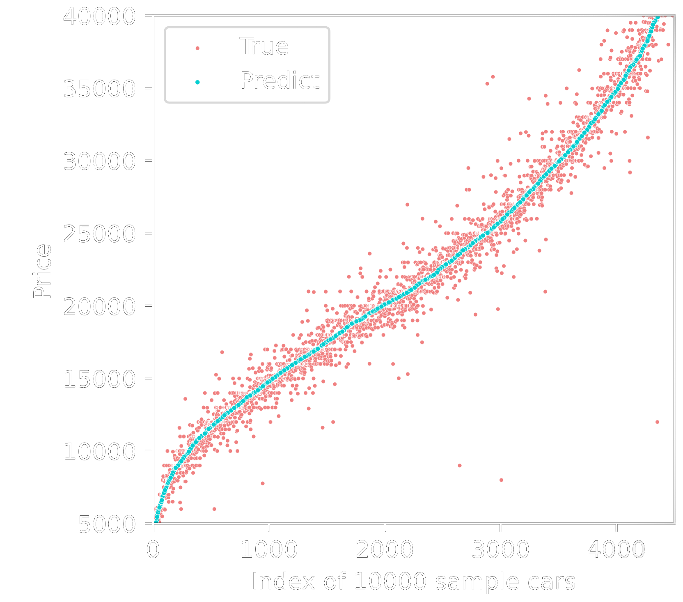

PREDICTION MODEL
Train RMSE: 1710.3
Validation RMSE: 2670.3

Slide 20
5
SOLUTION PART FIVE: UI & DEMO

Slide 21

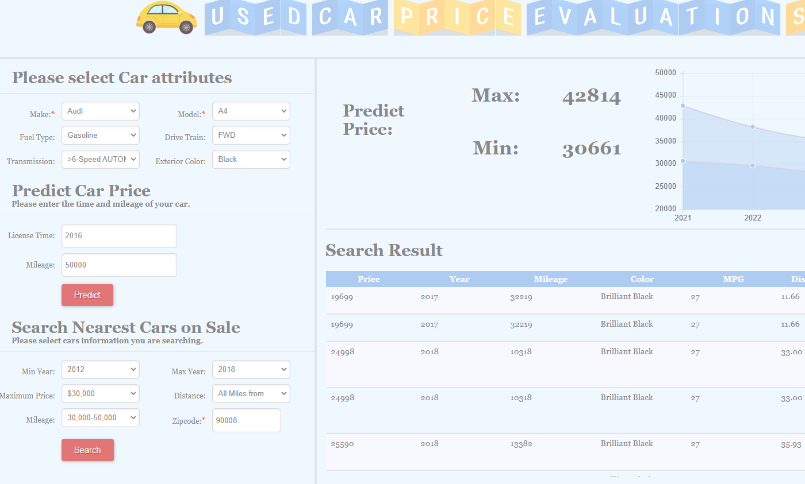
UI DESIGN

Slide 22
DSCI-551 Final Project
DEMO TIME
Tuo Sun, Yidan Wang, Xilai Nian

